Slide 1

Extension of Linear Regression
Multiple Linear Regression

Slide 2
Title and Content Layout with List
Multiple Linear Regression
Estimating the Regression Coefficients
Some Important Questions

Slide 3
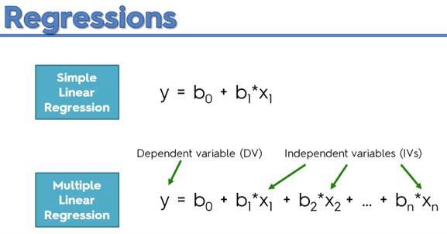
Simple vs Multiple linear regression

Slide 4
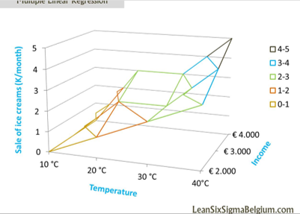
What is multiple linear regression?
Multiple linear regression (MLR), also known simply as multiple regression, is a statistical technique that uses several explanatory variables to predict the outcome of a response variable. The goal of multiple linear regression (MLR) is to model the linear relationship between the explanatory.

Slide 5
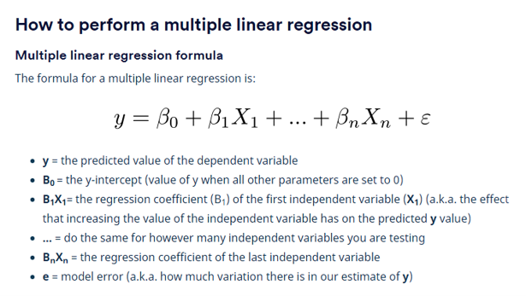

Slide 6
To find the best-fit line for each independent variable, multiple linear regression calculates three things:​
​
The regression coefficients that lead to the smallest overall model error.​
The t-statistic of the overall model.​
The associated p-value (how likely it is that the t-statistic would have occurred by chance if the null hypothesis of no relationship between the independent and dependent variables was true).​
It then calculates the t-statistic and p-value for each regression coefficient in the model.​

Slide 7
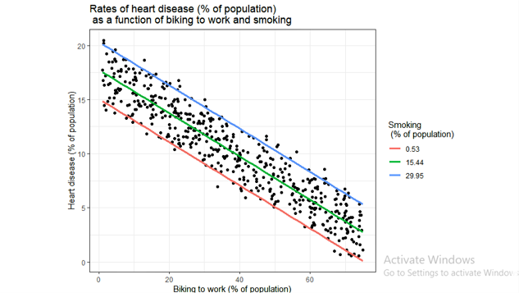
Visualizing the results in a graph

Slide 8

Estimating the Regression Coefficients

Slide 9
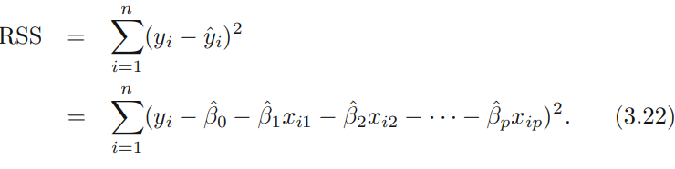
Estimating the Regression Coefficients
The parameters are estimated using the same least squares approach that we saw in the context of simple linear regression. We choose β0, β1,...,βp to minimize the sum of squared residuals

Slide 10
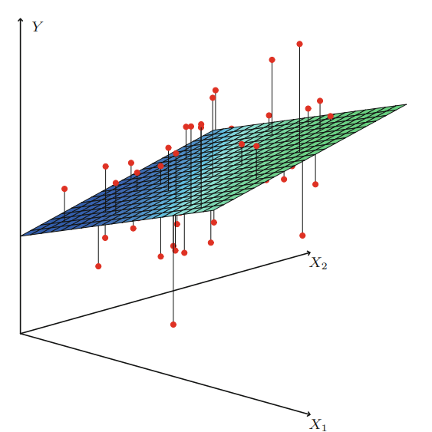
FIGURE
In a three-dimensional setting, with two predictors and one response, the least squares regression line becomes a plane. The plane is chosen to minimize the sum of the squared vertical distances between each observation (shown in red) and the plane.

Slide 11
Some Important Questions
When we perform multiple linear regression, we usually are interested in answering a few important questions.
1. Is at least one of the predictors X1, X2,...,Xp useful in predicting the response?
2. Do all the predictors help to explain Y , or is only a subset of the predictors useful?
3. How well does the model fit the data?
4. Given a set of predictor values, what response value should we predict, and how accurate is our prediction?

Slide 12
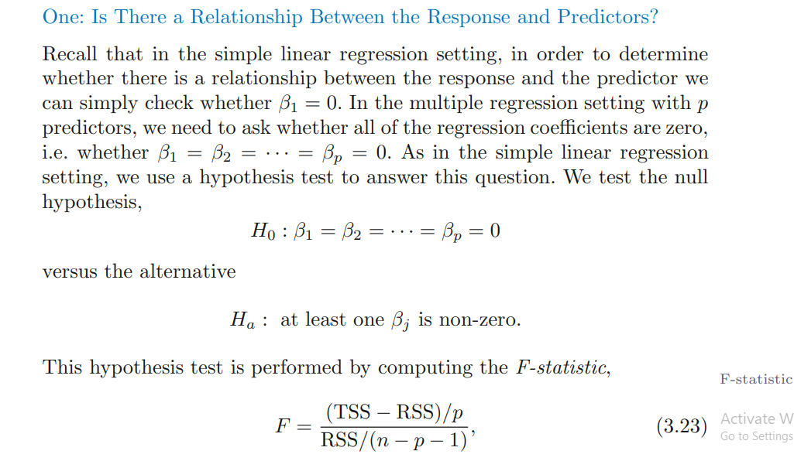

Slide 13
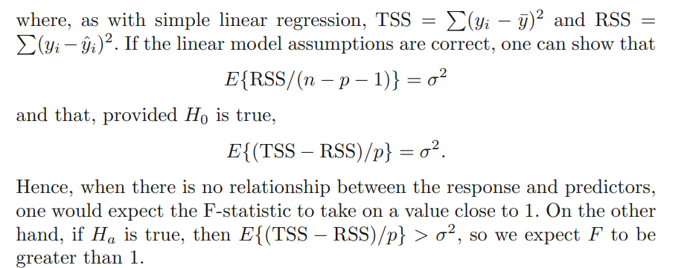

Slide 14
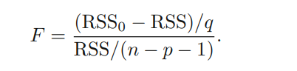
we are testing H0 that all the coefficients are zero. Sometimes we want to test that a particular subset of q of the coefficients are zero. This corresponds to a null hypothesis H0 : βp−q+1 = βp−q+2 = ... = βp = 0, where for convenience we have put the variables chosen for omission at the end of the list. In this case we fit a second model that uses all the variables except those last q. Suppose that the residual sum of squares for that model is RSS0. Then the appropriate F-statistic is

Slide 15

Two: Deciding on Important Variables

Slide 16

Forward selection. We begin with the null model—a model that con- forward selection null model tains an intercept but no predictors. We then fit p simple linear regressions and add to the null model the variable that results in the lowest RSS. We then add to that model the variable that results in the lowest RSS for the new two-variable model. This approach is continued until some stopping rule is satisfied.

Slide 17
Backward selection. We start with all variables in the model, and backward remove the variable with the largest p-value—that is, the variable selection that is the least statistically significant. The new (p − 1)-variable model is fit, and the variable with the largest p-value is removed. This procedure continues until a stopping rule is reached. For instance, we may stop when all remaining variables have a p-value below some threshold.

Slide 18
Mixed selection. This is a combination of forward and backward se- mixed lection. We start with no variables in the model, and as with forward selection selection, we add the variable that provides the best fit. We continue to add variables one-by-one. Of course, as we noted with the Advertising example, the p-values for variables can become larger as new predictors are added to the model. Hence, if at any point the p-value for one of the variables in the model rises above a certain threshold, then we remove that variable from the model. We continue to perform these forward and backward steps until all variables in the model have a sufficiently low p-value, and all variables outside the model would have a large p-value if added to the model.

Slide 19
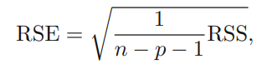
Three: Model Fit The observant reader may wonder how RSE can increase when newspaper is added to the model given that RSS must decrease. In general RSE is defined as

Slide 20
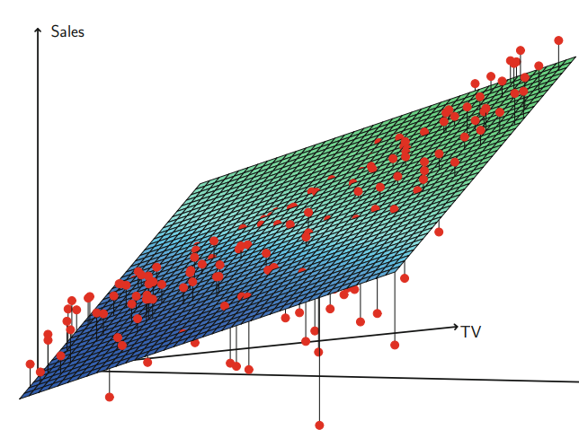
FIGURE
For the Advertising data, a linear regression fit to sales using TV and radio as predictors. From the pattern of the residuals, we can see that there is a pronounced non-linear relationship in the data. The positive residuals (those visible above the surface), tend to lie along the 45-degree line, where TV and Radio budgets are split evenly. The negative residuals (most not visible), tend to lie away from this line, where budgets are more lopsided.

Slide 21

Four: Predictions

Slide 22
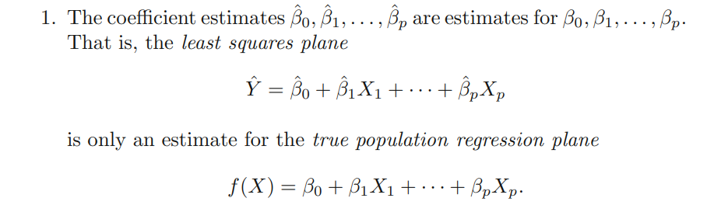

Slide 23
2. Of course, in practice assuming a linear model for f(X) is almost always an approximation of reality, so there is an additional source of potentially reducible error which we call model bias. So when we use a linear model, we are in fact estimating the best linear approximation to the true surface. However, here we will ignore this discrepancy, and operate as if the linear model were correct.

Slide 24
3. Even if we knew f(X)—that is, even if we knew the true values for β0, β1,...,βp—the response value cannot be predicted perfectly because of the random error in the model referred to this as the irreducible error

Slide 25
Thank you

